Slide 1
Profit Curves and Imbalanced Classes

Slide 2
Problem Motivation
Classification datasets can be “imbalanced”.
i.e. many observations of one class, few of another
Costs of a false positive is often different from cost of a false negative.
e.g. missing fraud can be more costly than screening legitimate activity
Accuracy-driven models will over-predict the majority class.
Notes:
Note: We are not talking about ‘cost functions’ here (i.e. we are not talking about objective functions here); we are instead talking about the ‘business cost’ of certain predictions mistakes.

Slide 3
Solutions
Cost-sensitive learning:
thresholding (aka “profit curves”)
modified objective functions
Sampling:
Oversampling
Undersampling
SMOTE - Synthetic Minority Oversampling TEchnique

Slide 4
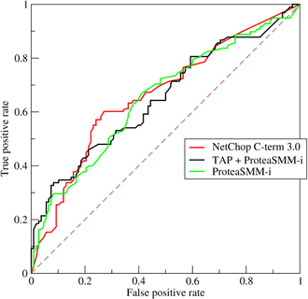
Cost-sensitive Learning - Thresholding
Recall the ROC Curve:
ROC shows FPR = (1-TNR) vs TPR (aka Recall)
doesn’t give preference to one over the other
Q: How to handle unequal
error costs?
A: Plot expected profit!

Slide 5
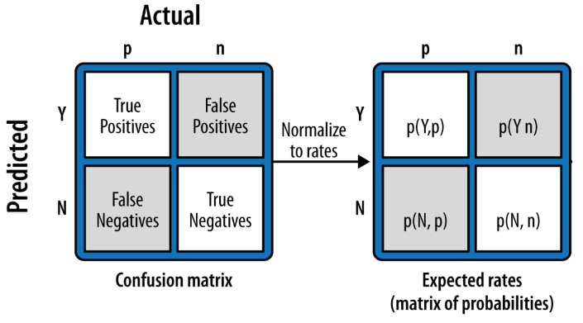
Cost-sensitive Learning - Thresholding
Computing Expected Profit
Step 1 - Estimate error probabilities.

Slide 6
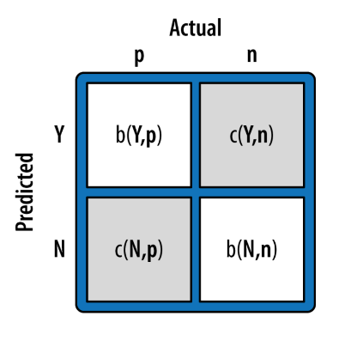
Cost-sensitive Learning - Thresholding
Computing Expected Profit
Step 2 - Define the cost-benefit matrix.

Slide 7
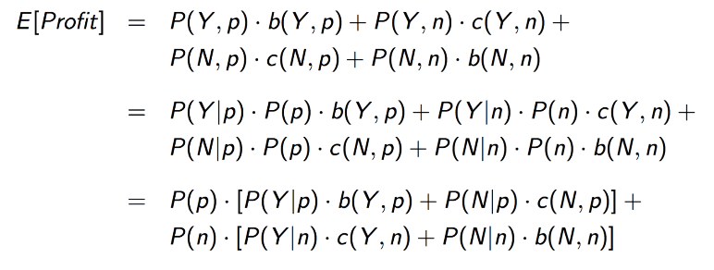
Cost-sensitive Learning - Thresholding
Computing Expected Profit
Step 3 - Combine probabilities and payoffs.
Notes:
The third way of writing this is nice because it allows us to change the class ‘priors’ by hand and see what happens. The other terms do not depend on the priors, so we can change the priors any way we’d like -- but most likely we’ll change them to match real-world so that we have an idea of the profit in the real-world.

Slide 8
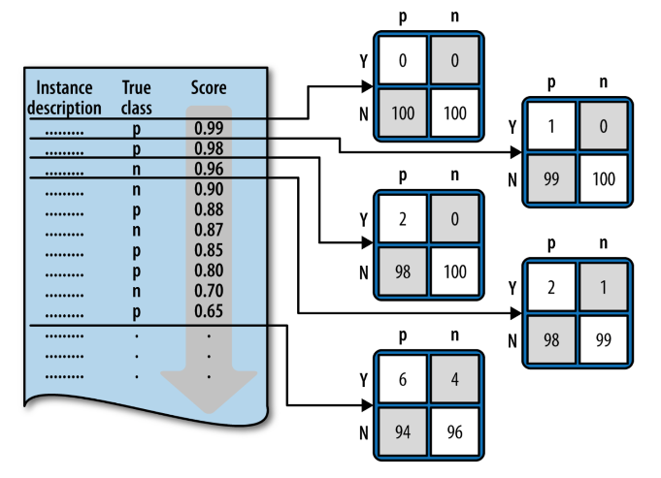
Cost-sensitive Learning - Thresholding
Find the profit-maximizing threshold
For each possible threshold, compute expected profit.
Then select threshold with highest expected profit.
Notes:
Note: There are at most n thresholds with distinct profit values.

Slide 9
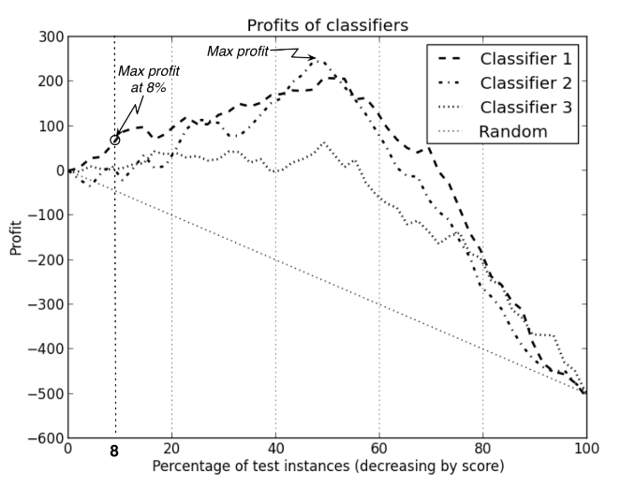
Cost-sensitive Learning - Thresholding
Percent of test instances (decreasing by score)

Slide 10
Cost-sensitive Learning
Modified Objective Functions
Models with explicit objective function can be modified to incorporate classification cost.
e.g. logistic regression
This will affect optimization.
e.g. cost-sensitive logistic regression is not convex!
Not all models have a cost-sensitive implementation.

Slide 11
Sampling Techniques - Undersampling
Undersampling randomly discards majority class observations to balance training sample.
PRO: Reduces runtime on very large datasets.
CON: Discards potentially important observations.
Notes:
Note: Maybe we can bag models where each uses an undersampled majority class…?

Slide 12
Sampling Techniques - Oversampling
Oversampling replicates observations from minority class to balance training sample.
PRO: Doesn’t discard information.
CON: Likely to overfit.
(Often better to use SMOTE)

Slide 13
Sampling Techniques - SMOTE
SMOTE - Synthetic Minority Oversampling TEchnique
Generates new observations from minority class.
For each minority class observation and for each feature, randomly generate between it and one of its k-nearest neighbors.

Slide 14
Sampling Techniques - SMOTE
SMOTE pseudocode
synthetic_observations = [] while len(synthetic_observations) + len(minority_observations) < target: obs = random.choice(minority_observations): neighbor = random.choice(kNN(obs, k)) # randomly selected neighbor new_observation = {} for feature in obs: weight = random() # random float between 0 and 1 new_feature_value = weight*obs[feature] \ + (1-weight)*neighbor[feature] new_observation[feature] = new_feature_value synthetic_observations.append(new_observation)
See also psuedo-code in original SMOTE paper: https://www.jair.org/media/953/live-953-2037-jair.pdf

Slide 15
Sampling Techniques - Distribution
What’s the right amount of over-/under-sampling?
If you know the cost-benefit matrix:
Maximize profit curve over target proportion
If you don’t know the cost-benefit matrix:
No clear answer...
ROC’s AUC might be more useful...

Slide 16
Cost Sensitivity vs Sampling
Neither is strictly superior.
Oversampling tends to work better than undersampling on small datasets.
Some algorithms don’t have an obvious cost-sensitive adaptation, requiring sampling.
See also “Cost-Sensitive Learning vs. Sampling: Which is Best for Handling Unbalanced Classes with Unequal Error Costs?” http://storm.cis.fordham.edu/gweiss/papers/dmin07-weiss.pdf

Slide 17




Evaluating a Binary Classifier
Confusion Matrix Classifier Metrics
Accuracy
True Positive Rate (Sensitivity/Recall)
True Negative Rate (Specificity)
Precision
 | Actually Positive | Actually Negative
Predicted Positive | True Positives | False Positives
Predicted Negative | False Negatives | True Negatives
Notes:
\frac{TP}{P}=\frac{TP}{TP+FN}
\frac{TN}{N}=\frac{TN}{TN+FP}
TODO - add accuracy to this slide
TODO - think of questions to ask students that would make them weight precision/recall etc.
-TPR = probability that a positive result is labeled as such
-FPR = probability that a negative result is labeled as such
-Precision = probability that something labeled positive is actually positive

Slide 18
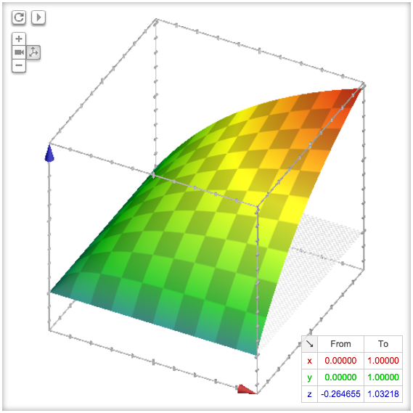


Evaluating a Binary Classifier
F1 Score
harmonic mean of precision and recall
Fβ Score
Notes:
Suppose you want a single number that combines precision and recall into a balanced metric:
- f1 is popular in text classification and named entity recognition
- note that precision and recall are special cases of Fbeta, beta = 0 is precision, beta = inf is recall

Slide 19
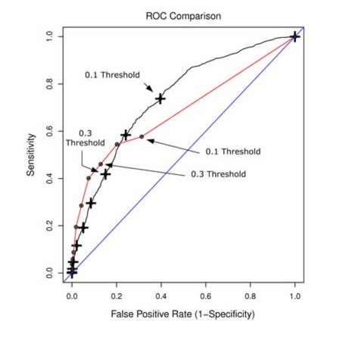
Evaluating a Binary Classifier
ROC Plot
If classifier A’s ROC curve is strictly greater than classifier B’s, then classifier A is always preferred.
If two classifier’s ROC curves intersect, then the choice depends on relative importance of sensitivity and specificity.

Slide 20
Evaluating a Binary Classifier
ROC - Area Under Curve (AUC)
Equals the probability that the model will rank a randomly chosen positive observation higher than a randomly chosen negative observation.
Useful for comparing different classes of models in general setting.

Slide 21
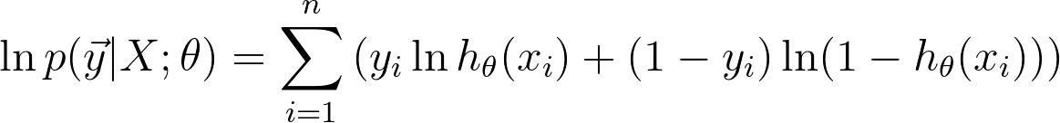
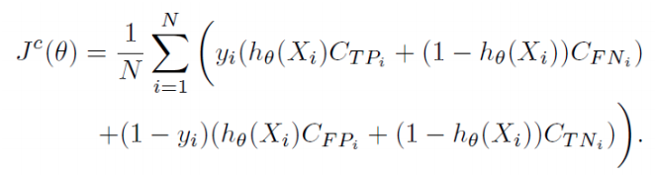
Cost-sensitive Logistic Regression
Logistic regression’s usual objective function:
New objective function, representing expected cost:
Note that the cost-sensitive objective function is not convex!
Notes:
2nd equation from: http://albahnsen.com/files/Example-Dependent%20Cost-Sensitive%20Logistic%20Regression%20for%20Credit%20Scoring_slides.pdf

Slide 22
Cost-sensitive Logistic Regression
Logistic regression goal: accurately estimate parameter of Bernoulli random variables
Cost-sensitive logistic regression goal: minimize misclassification cost
Both assume that observations are Bernoulli

